Slide 1
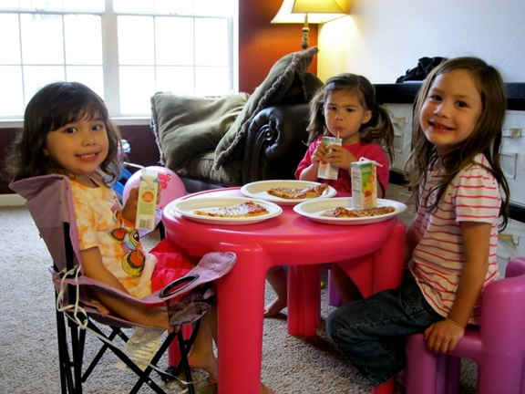
Play Date
Notes:
Please see the How to Use Personalized Stories document for more information on how to edit and display this PowerPoint presentation for your child.
Please customize this template to best help your child by:
Modifying the template to use your child’s name
Using language that is familiar to your child
Including items that are of great interest to your child
Adding photos of your child or family to all of the blue frames in this template.
Adding photos and new slides from your own child’s life to this template.
Changing any of the text, photos, or images in this template with photos or images that are more meaningful to your child

Slide 2
I am having a play date.
A play date means that my friend [Friend’s name] is coming over to my house to play with me!
Play dates are so much fun!

Slide 3
It is okay to be a little worried about the play date.
My mom or dad will help me get ready.
I can put some of my favorite toys in a safe place if I am worried about them breaking or being played with.

Slide 4
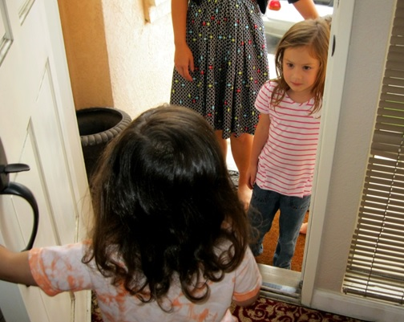
When my friend arrives I can meet him/her at the door and say “hi”.

Slide 5
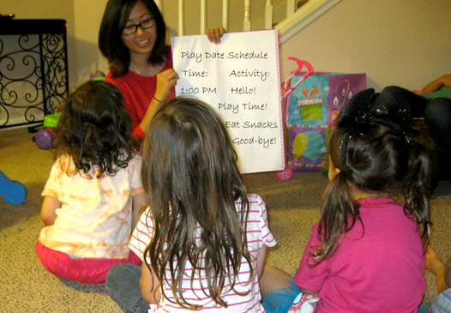
First, my mom or dad will go over the schedule with us.
It is a good idea to have a schedule so I know what we will be doing.
I can play and have fun!

Slide 6
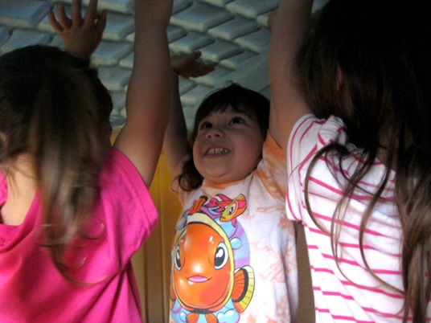
When [Friend’s name] is at my house, s/he will have an idea about how s/he wants to play with things.
S/he might say or do things in a way that is different from what I am used to in my house. This is okay.
I can use my words to say if I want to play a certain way or to ask him/her to stop.

Slide 7
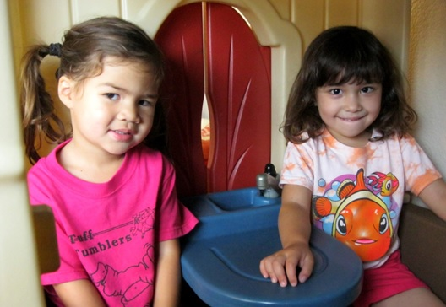
I should be flexible when [Friend’s name] is over at my house.
It takes a lot of courage to play at someone’s house and a lot of courage to have a friend over to play.

Slide 8
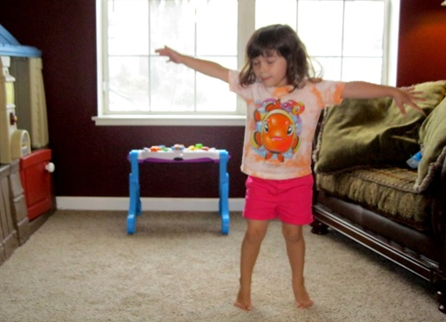
If I get frustrated by something [Friend’s name] is doing, I can take a deep breath and go tell mom/dad that I need a break.
After my break we can do something else.
Play dates are so much fun!

Slide 9
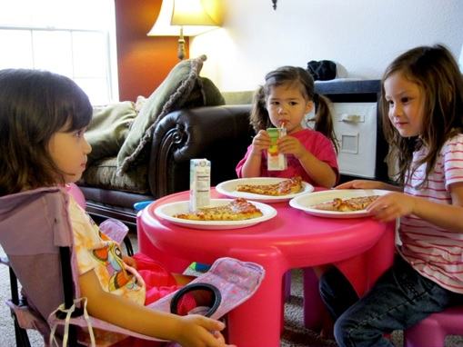
During our play date we will have a snack together.
I should ask questions about what s/he likes and we can take turns talking about what our favorite things are.

Slide 10
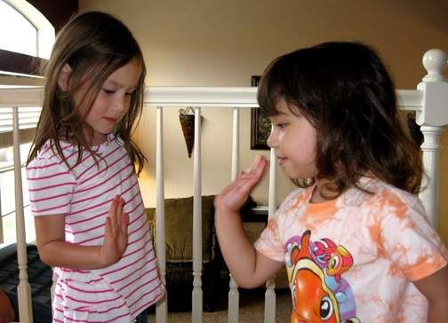
After the play date, [Friend’s name] will go home. When s/he goes home, I can say “thank you for playing” and ask to have another play date soon.
I can give [Friend’s name] a high five or a hug if it is okay with him/her.

Slide 11
It is fun to play with my friends and have play dates!

Slide 12
Things to Try
Create a schedule:
Time | Event
1:00 | My friend arrives
2:00 | We have a snack
4:00 | My friend goes home. We had fun.

